Slide 1
基於時序金字塔之第一人稱影像行為辨識 Activity Recognition in First-Person Camera View Based on Temporal Pyramid
Speaker: Hsaun-Ming Liu
Advisor: Ming Ouhyoung, Ph.D

Slide 2
Outline
Introduction
Related work
System Overview
Method
Experiments & Results
Demo
Conclusion

Slide 3
Introduction

Slide 4
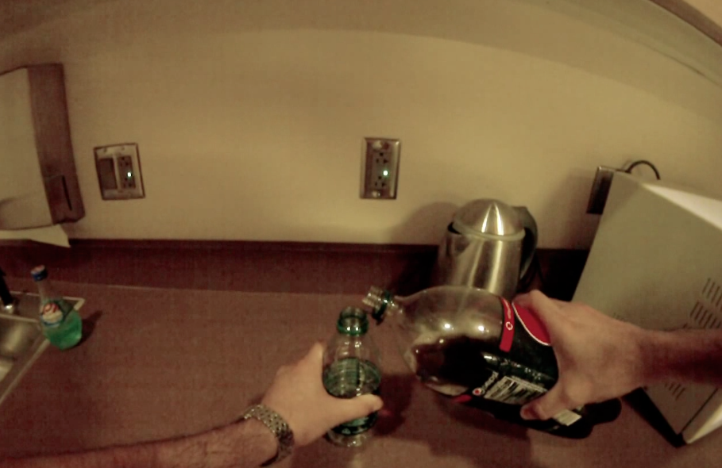

Problem Definition
First-Person-View Videos
Ongoing Activity
Notes:
當我們擁有第一人稱影片,如何去辨識畫面中主角正在從事的行為

Slide 5
Problem Definition
First-Person-View Videos
Activity of Daily Life
Eating,
Drinking,
Laundry,
etc.
Notes:
在碩論中先限縮問題範圍

Slide 6
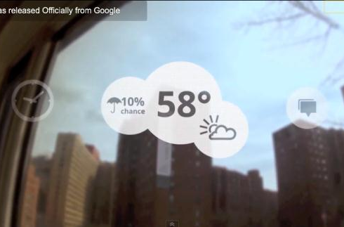
Motivation
Multimodal Context Aware Service

Slide 7
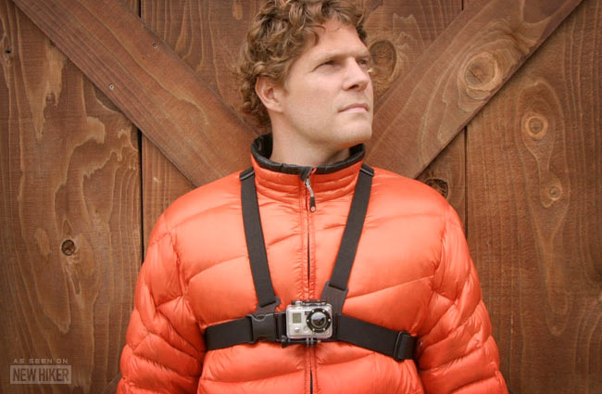

The Time has Come
Device : GoPro camera, Google Glass

Slide 8
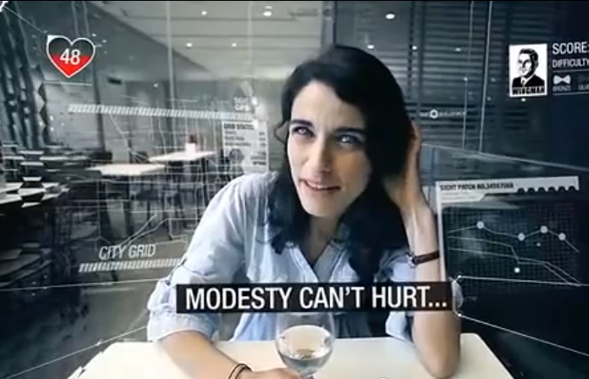
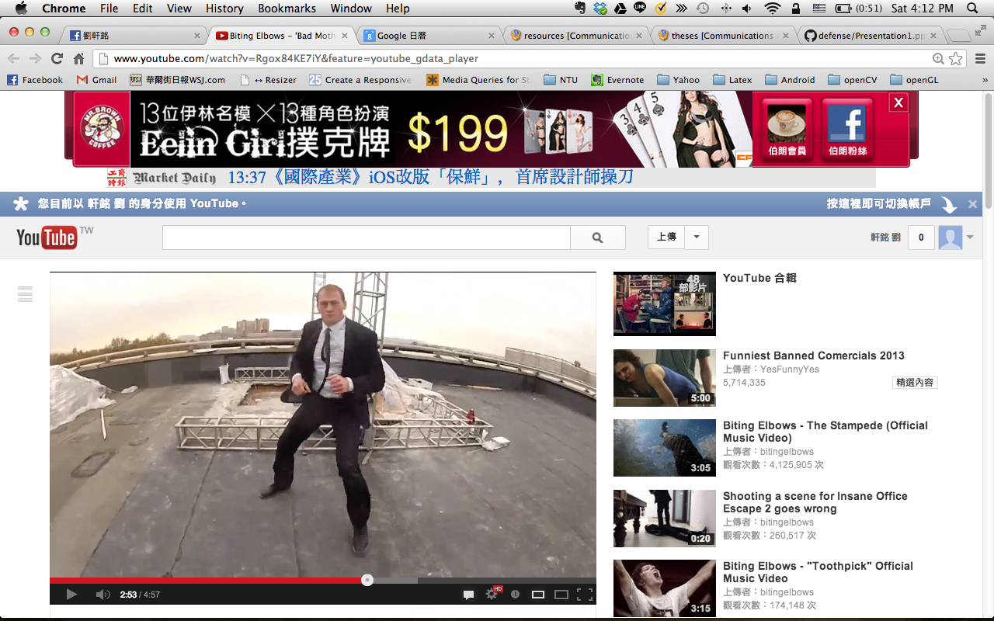
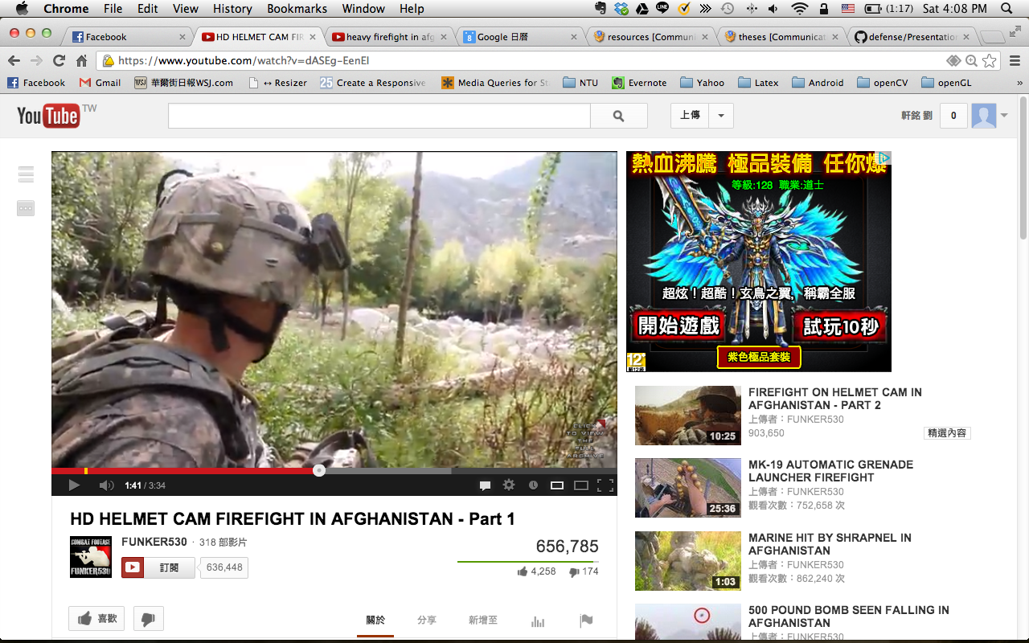
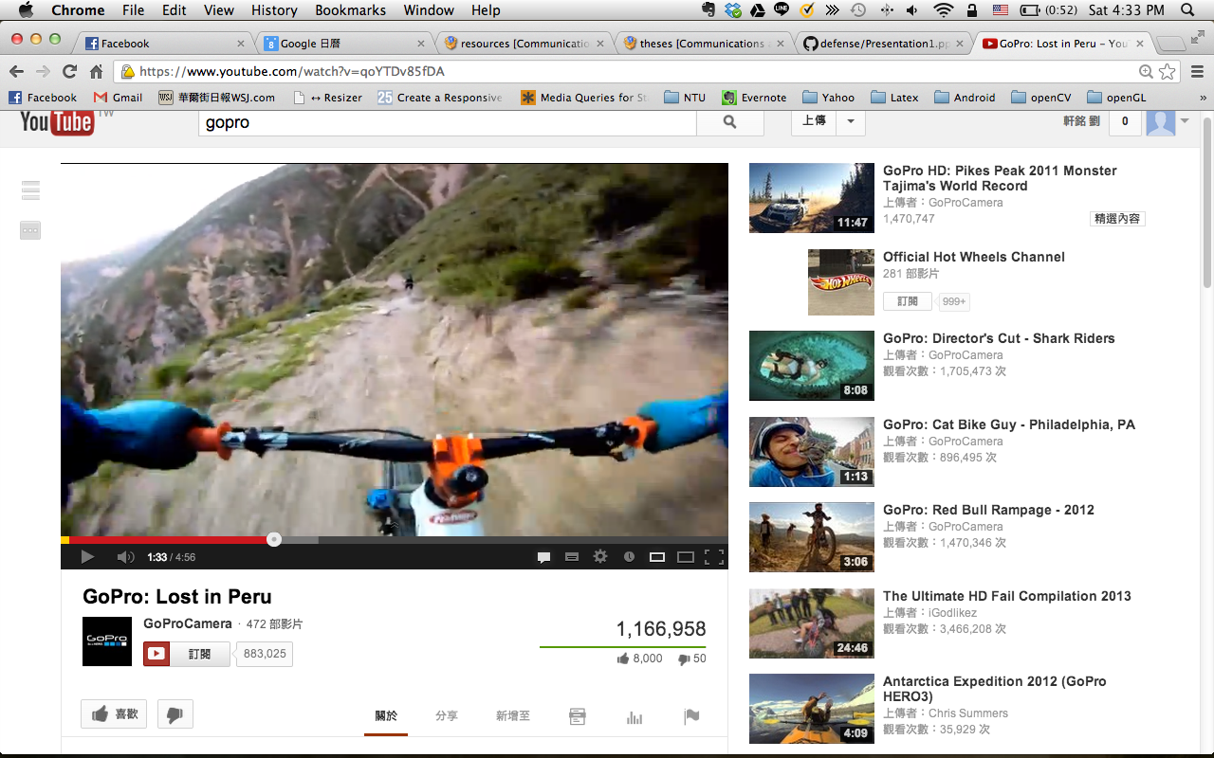
The Time has Come
Contents

Slide 9
Related Work

Slide 10
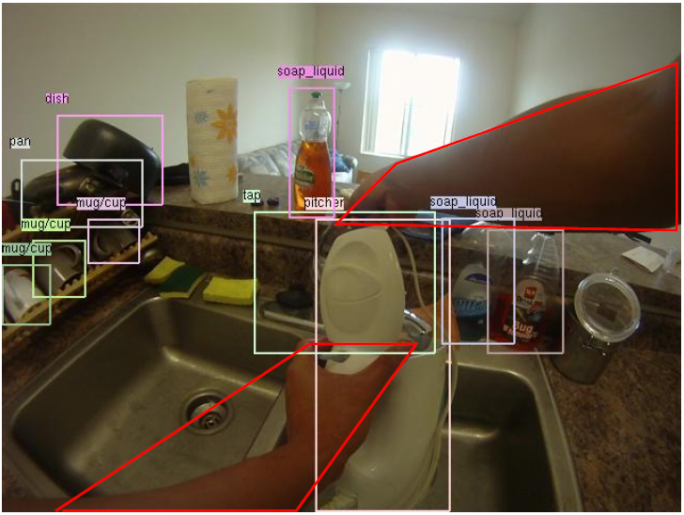
Related Work
Conditional Random Fields for Activity Recognition [Vail et al., 07]
Detecting Activities of Daily Living in First-person Camera Views [Pirsiavash et al., 12]
Notes:
Conditional Random Fields for Activity Recognition:
In cases where features depend on observations from many time steps, we confirm that CRFs are robust against any degradation in performance
在機器人領域” In the robot tag domain, we wish to identify which robot is the seeker at each time step of the simulation”, features: Raw Positions, Velocities,

